Slide 1
Solving Graph Isomorphism with Minimum Bit Strings
Josh Krcadinac
Rafael Lastiri

Slide 2
Overview
What is Graph Isomorphism
Applications
Bit String Background
Our Contribution
Results
Questions

Slide 3
What is Graph Isomorphism
Two graphs are isomorphic if we can find a permutation of the set of edges and vertices of one graph and map them to the edges and vertices of the second graph
Requires the same:
Number of vertices
Number of Edges
Vertex degrees
Graph structure

Slide 4
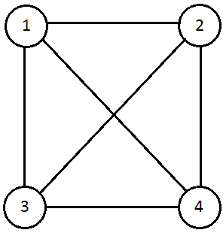
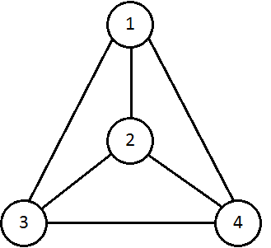
Graph 1
Graph 2

Slide 5
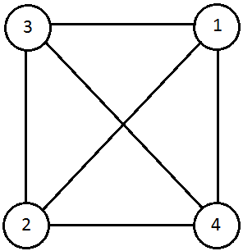
Note: Two graphs can have more than one isomorphism
Graph 2 can map onto Graph 1

Slide 6
Applications
Chemistry
Checking if molecular structures equivalent
Cryptography
Replacing classical S-Box
File Comparison
Social network pattern Analysis
Suspicious behavior
Civil Engineering
Looking for desired geographic locations
Notes:
Chemistry – same formula different structure
Crypto – replacing standard sbox with isomorphic equivalent
File comparision
Social Networks – identify suspicious behvaiours
Civil Engineering – look for desired locations

Slide 7
Bit String Background
Make an adjacency matrix of a graph
Combine the rows together to make a bit string
We only care about the top right half
Want to find and keep the minimum
Brute force: O(n!)
 | 1 | 2 | 3 | 4 | 5
1 | 0 | 1 | 0 | 1 | 0
2 | 1 | 0 | 1 | 1 | 0
3 | 0 | 1 | 0 | 0 | 0
4 | 1 | 1 | 0 | 0 | 1
5 | 0 | 0 | 0 | 1 | 0
We get bit strings:
1010, 110, 00, 1
Minimum ordering:
0010101101
Notes:
We only care about top right half because the bottom left is a mirror

Slide 8
Our Contribution
Idea: Break previous method into smaller cases using recursion
Can reduce the overall possible orderings of n vertices
Problem: Deal with box of values coming out of the recursion
Determine run time
 | 1 | 2 | 3 | 4 | 5 | 6 | 7 | 8
1 | 0 | 1 | 0 | 1 | 0 | 1 | 1 | 0
2 | 1 | 0 | 1 | 1 | 0 | 0 | 0 | 0
3 | 0 | 1 | 0 | 0 | 0 | 1 | 1 | 0
4 | 1 | 1 | 0 | 0 | 1 | 0 | 0 | 1
5 | 0 | 0 | 0 | 1 | 0 | 1 | 0 | 1
6 | 1 | 0 | 1 | 0 | 1 | 0 | 1 | 0
7 | 1 | 0 | 1 | 0 | 0 | 1 | 0 | 0
8 | 0 | 0 | 0 | 1 | 1 | 0 | 0 | 0

Slide 9
Results
Coded out regular Minimum Bit String method for finding isomorphism's
It worked, but O(n!)
Attempted a recursive solution

Slide 10
Results (cont’d)
Worked/didnt

Slide 11
Questions?

